Slide 1
Sprint 4 - Presentation
By: Juliana Gomez, Vincenzo Rea, & Ava Ondecker

Slide 2
Challenges we have faced in the process
The biggest challenge we faced as a group during this project was the lack of communication. Everyone did their roles and took part in the project in some way, however, there was a lot of miscommunication and members on different pages. Another challenge we faced was finding time to test and video record the sprints. We all had different schedules and they never lined up, resulting in having to go into the classroom after hours (which was not always permitted).

Slide 3
Roles of each team member
Juliana Gomez: Project manager and coder. This role was in charge of managing the group as an effective team, along with writing the block codes for each triathlon.
Vincenzo Rea: Documentation and algorithm. This roll consists of making sure all of the documentation and requirements for the repository were completed.
Ava Ondecker: Tester and coder. This roll was in charge of testing for trial and errors within the block codes written. This roll also tested different block codes.

Slide 4

What we have learned about software engineering
We have discovered that software engineering is a meticulous process, but rewarding in the end if you get it right
The entire code can be messed up if one step is off
We all enjoyed the process of software engineering like creating the block code
There is an immense amount of trial and error in this field, you will need a lot of patience

Slide 5
What we would do differently
If we had to do this again, we would structure our plan to do each sprint better
Sometimes we didn’t communicate as much as we should’ve as a group, but improved this towards the end

Slide 6
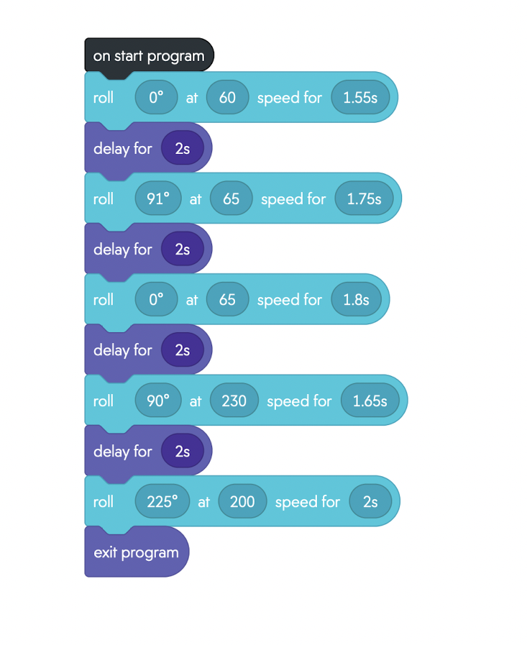
Block code for Sprint 3- Agility
Trial and Error
Finding right speed
Estimating right time
Benefits of coding while robot on the course

Slide 7
Sprint 3 Agility video
https://youtu.be/EBcXnMG2pSE
**Link will take you to youtube video**

